Slide 1



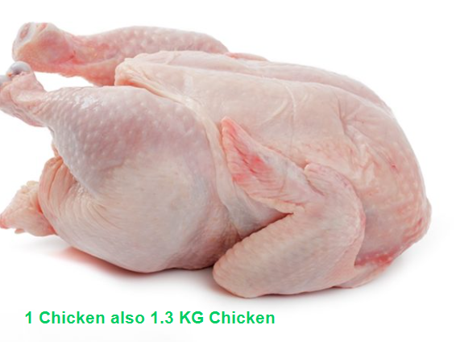

Catchweight in Oracle NetSuite
FernSpeed SuiteApp v2026.1
Catchweight in F&B is the ability to measure the actual weight of a product at the time of sale/purchase/transfer or usage simultaneously as another measured unit. This is common for fresh produce, meat, seafood, and other perishable items.
For example, A Chicken is measured in each’s but also has the weight of 1.4 KG. When weighed at the checkout or used in production, the actual weight might be 1.3 KG. The usage would then be charged based on the actual weight (catchweight) of the Chicken. Both units need to be monitored in NetSuite
Key points about catchweight in NetSuite: The base unit in NetSuite is the unit for costing and GL Postings, for Chicken this will be Kgs.
No changes have been made to the NetSuite standard GL engine or the standard NetSuite inventory engine to maintain the upgrade path and NetSuite integrity.
Separate custom inventory records are used to monitor and maintain the catchweight unit

Slide 2
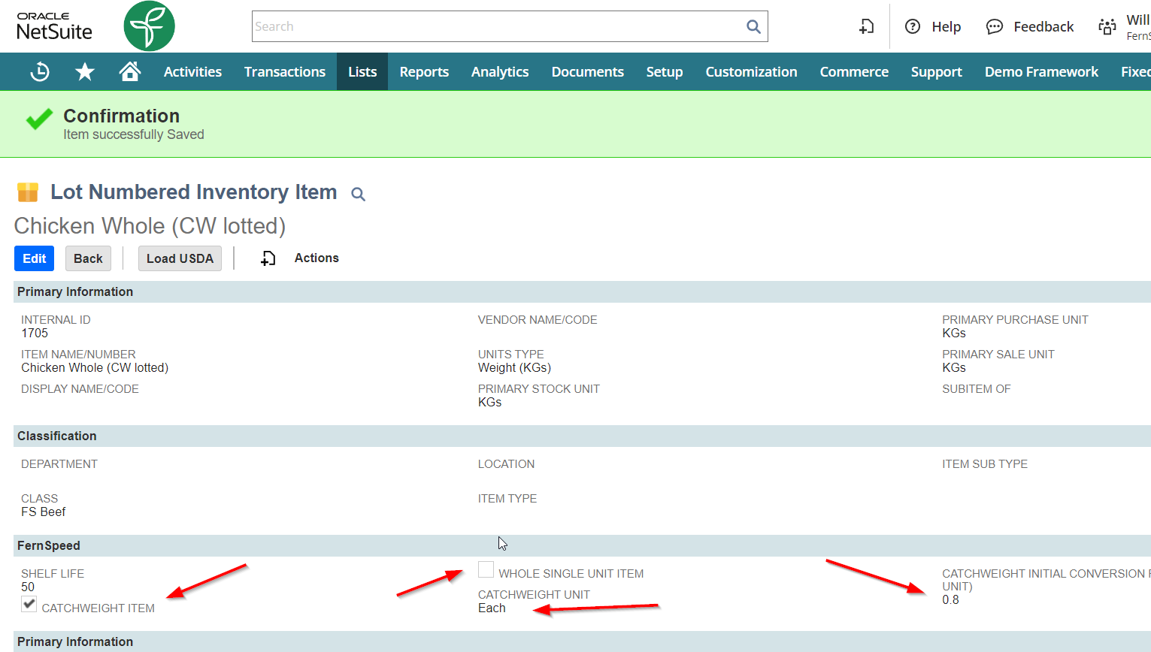
Item Setup
Standard lot numbered item primary unit in this example is KGs
Checkbox to indicate lot numbered item is a catchweight item
Catchweight Unit – in this example is Each
Default Conversion to catchweight UOM – in this example 1 Chicken is 1.25KG (1KG/0.8 Each)
Whole Single Unit Item flag – if selected this flag will create 1 of each catchweight unit for tracking

Slide 3
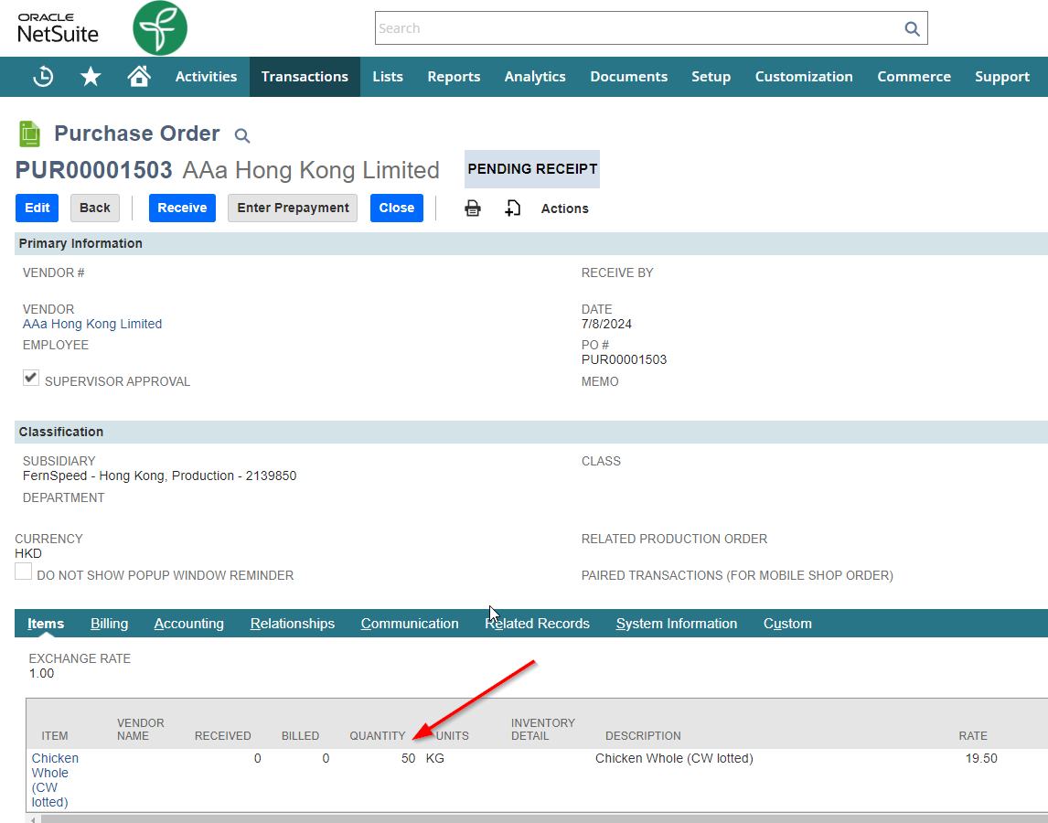
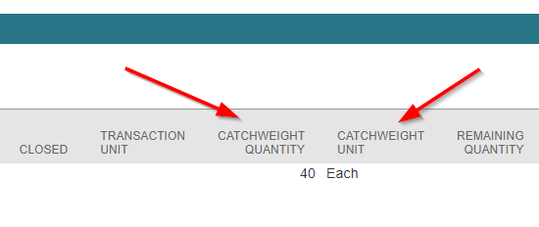
Purchase Order
Purchase order as standard – 50KGs ordered
Catchweight Unit is Each
Default Conversion to catchweight unit gives 40 Eachs for 50 KGS (50KG * 0.8 Catchweight factor)
This can be edited if needed on the order line
Purchase Order printout (advanced PDF) can show the catchweight unit

Slide 4
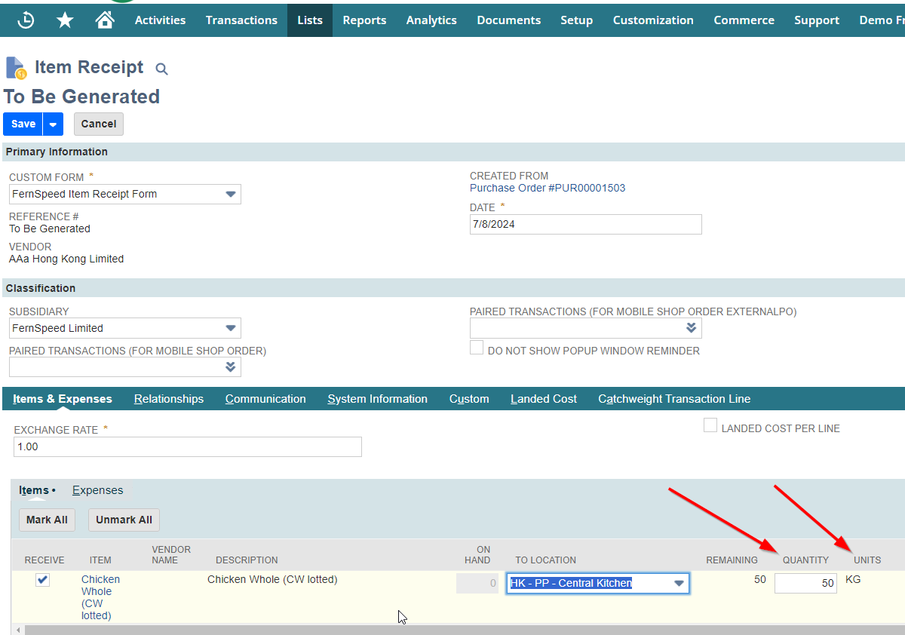
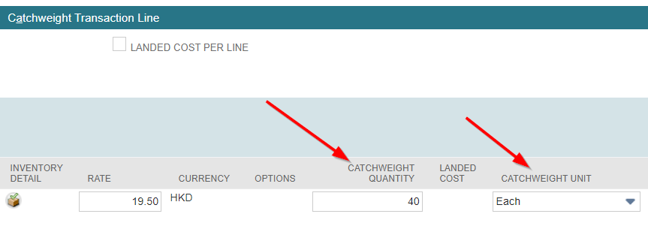
Item Receipt, pt 1
Item Receipt as standard – 50KGs ordered, can be changed etc.
Catchweight qty can be edited if needed on the receipt line

Slide 5
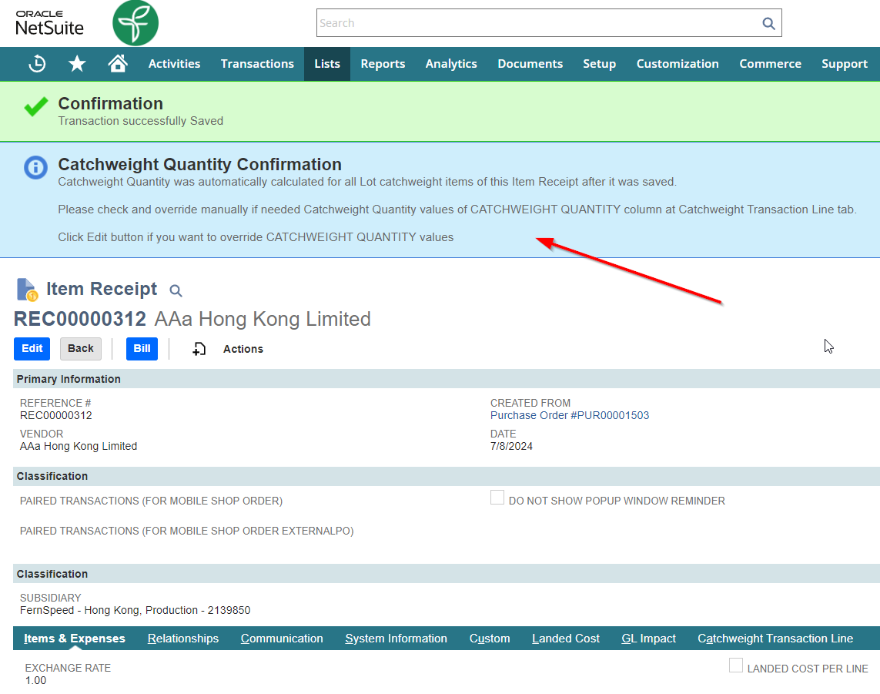
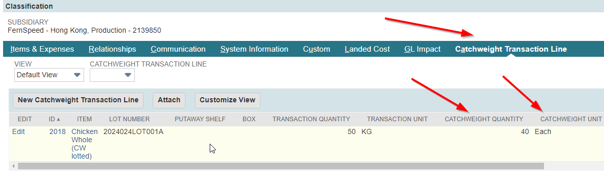
Item Receipt, pt 2
After receipt can edit the lines and adjust quantities

Slide 6
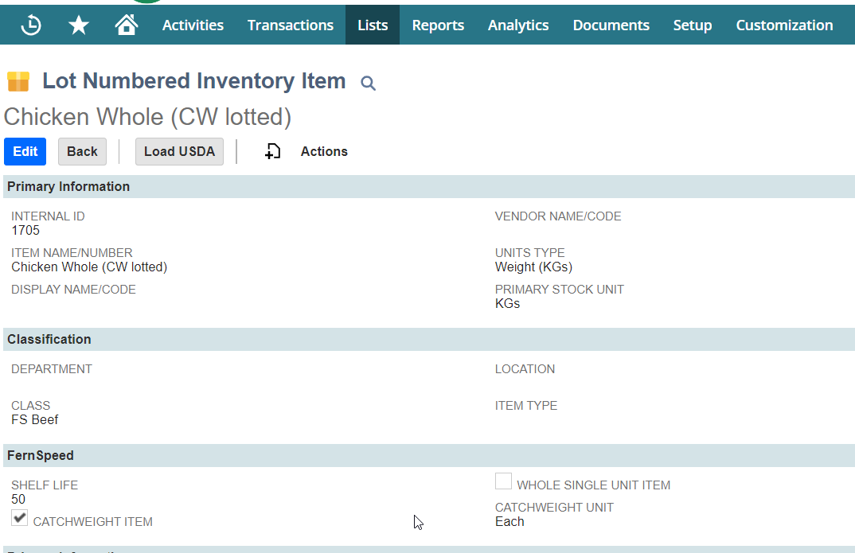
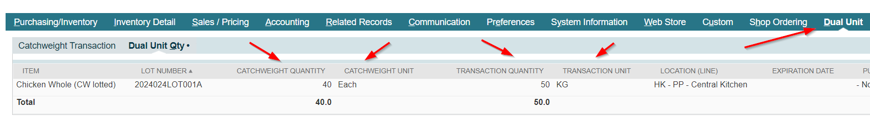
Item Master
In item master can view the catchweight transaction quantities

Slide 7
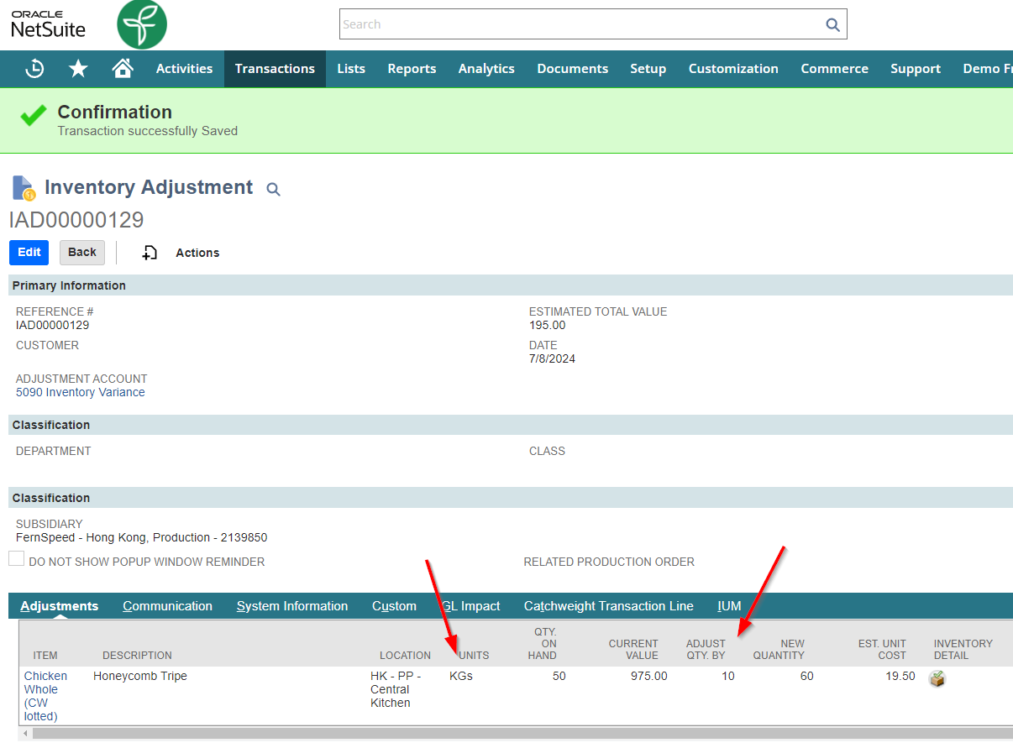
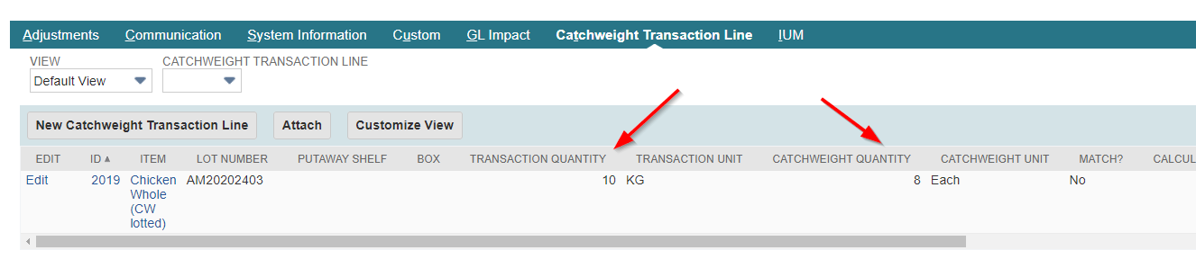
Inventory Adjustment
Inventory adjustment as standard – 10KGs increased, can be changed etc.
Catchweight qty can be edited if needed on the line
Catchweight transaction line is created (custom record)
Can be negative quantity also

Slide 8
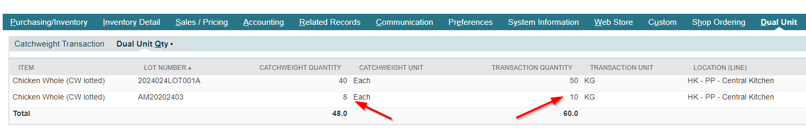
Item Master
In item master can view the catchweight transaction quantities

Slide 9
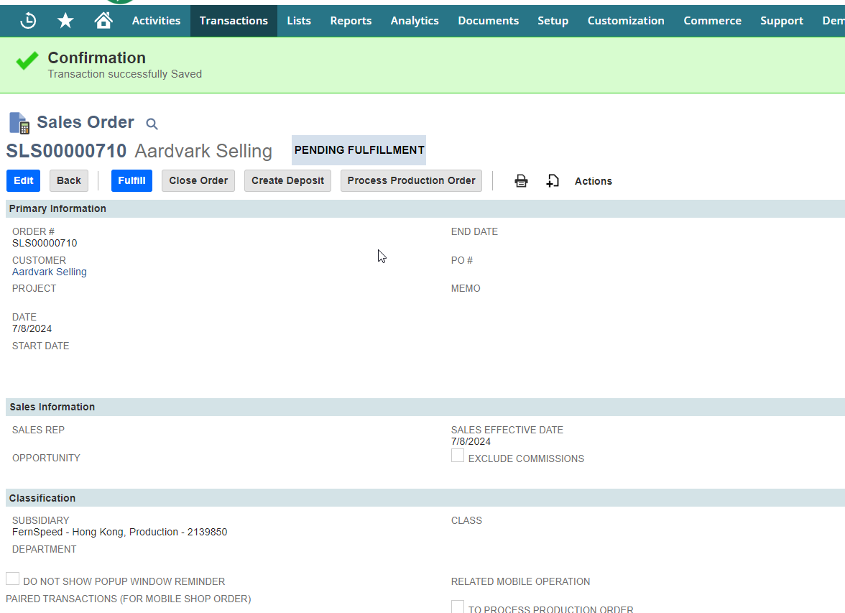
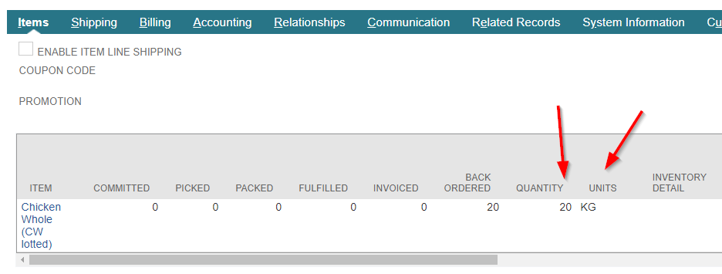
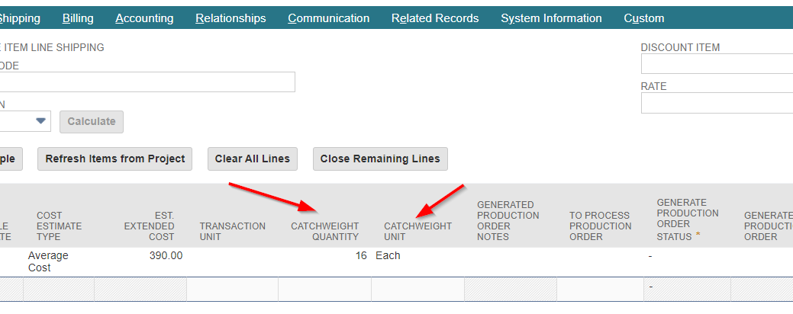
Sales Order
Can add catchweight quantities to the SO line

Slide 10
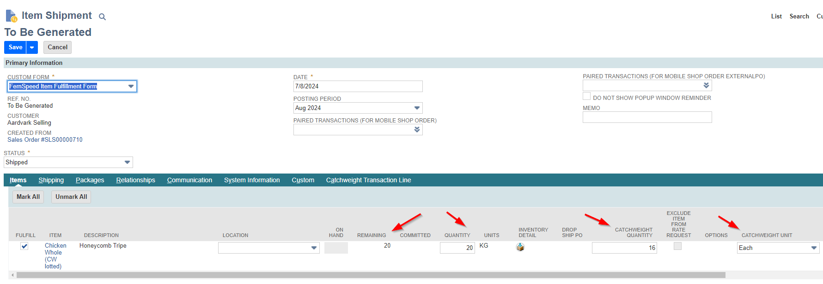
Fulfilment, pt 1
Can add catchweight quantities to the line

Slide 11
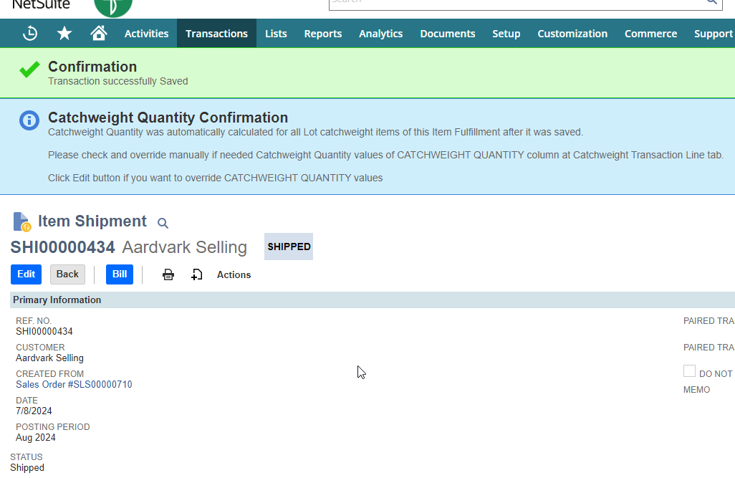
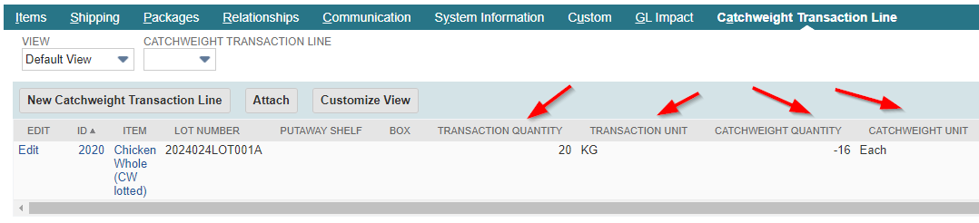
Fulfilment, pt2
Can alter quantities and details appear in the sub list

Slide 12

Thank you!!
will@fern.com.hk
+63 9777 2290 94 (Philippines)
Contact Us
 | info@fern.com.hk
 | https://fernspeed.fern.com.hk/
Hong Kong Office: |  | Manila Office:
 | +852 2899 2273 |  | +63 2 8776 8307
 | 608, Sunbeam Centre, 27 Shing Yip Street, Kwun Tong, Hong Kong |  | Level 10-01 One Global Place 25th Street & 5th Avenue, BGC, Taguig City, NCR, Manila, Philippines 1632

